Slide 1
CS492 - Operating Systems Processes in Linux
Georgios Portokalidis & Jun Xu
MOS 10.3.1, 10.3.2, 10.3.3, LDD 2
Slides credit: Antonio Barbalace

Slide 2
Implementation of Processes in Linux (1)
Every process has a user and a kernel part
User-space is running the program
Kernel-space is running kernel code on behalf of program
A user-space execution context and a kernel-space execution context
For each process, 2 PCs, 2 stack ptr, 2 stacks, 2 register sets …
One user and one kernel
Those are two different address spaces (including code, data, …)
User or kernel, the work is accounted to the same process

Slide 3
Implementation of Processes in Linux (2)
Syscalls recap
Move the CPU execution from application to OS
From executing application’s code to OS’s code
The OS code is not in the application address space
The OS code is in its own address space
Switch execution context
From user to kernel spaces
But it is about the same process

Slide 4
task_struct (1)
Processes are tasks: A task_struct represents a process
Categories of information in the task_struct
Scheduling parameters
Memory image
Signals
Machine registers
System call state
File descriptor table
Accounting
Kernel stack
Miscellaneous

Slide 5
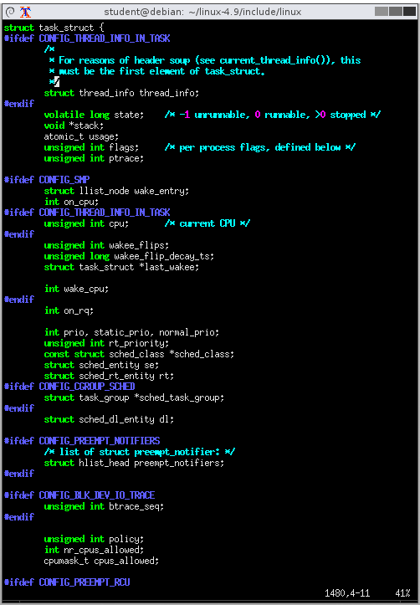
task_struct (2)
include/linux/sched.h:1475
Interesting fields
long state
void *stack
uint flags
int on_cpu
int prio, static_prio, normal_prio
cpumask_t cpus_allowed
struct mm_struct *mm
pid_t pid, tgid
struct task_struct *parent
u64 start_time
char comm[TASK_COMM_LEN]
Program executable

Slide 6
task_struct (3)
Kernel code can refer to the current task by using the macro current
Defined in <asm/current.h>
Yields a pointer to a struct task_struct
The current pointer refers to the task that is currently executing in user space
printk(KERN_INFO “Task \"%s\" (pid %i) on CPU %d\n",
current->comm, current->pid, current->on_cpu);

Slide 7
From fork() To clone()

Slide 8
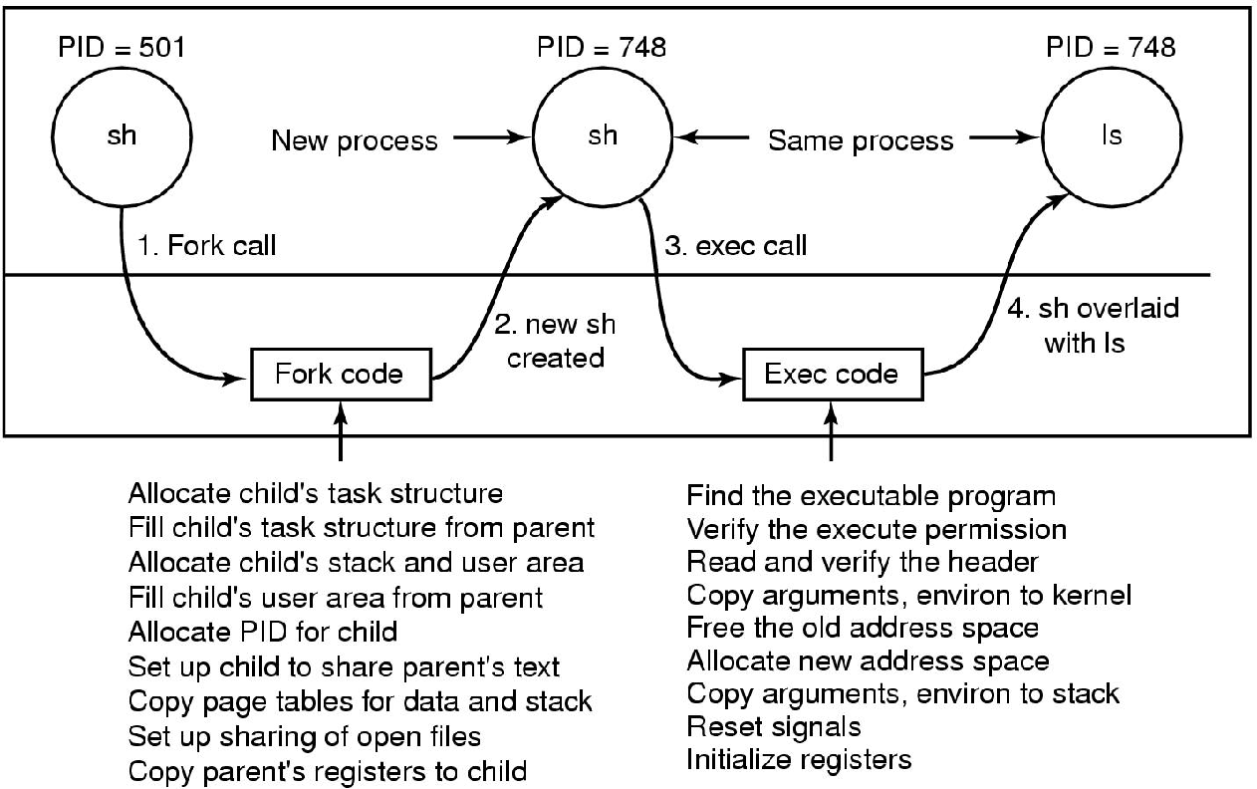
Implementation of exec()
User
(same program)
(different program)
Kernel
The steps in executing the command ls typed to the shell (MOS Figure 10-8)

Slide 9
fork() & execve()
fork()
Creates a new process
execve()
Installs a new program in the process
Both fork() and execve() are syscalls
Process creation is done by clone() syscall

Slide 10
The clone() System Call (1)
child_id = clone(function, stack_ptr,
sharing_flags, arg);
Introduced in Linux in 2000
Notes:
At very high level you can think about clone as the equivalent of fork but for thread, in the sense that it creates a new thread such as fork creates a new process
However, remember that fork doesn’t have any argument, while clone has multiple arguments, DISCUSS THE ARGUMENTS

Slide 11
The clone() System Call (2)
Clone is special
Blurs the distinction between process and thread creation
It creates processes or threads
Creates a new task
New process → The address space is not shared
Linux assigns PID
PID based on clone’s parameters
Notes:
The call creates a new thread, either in the current process or in a new process, depending
on sharing flags. If the new thread is in the current process, it shares the
address space with the existing threads, and every subsequent write to any byte in
the address space by any thread is immediately visible to all the other threads in
the process. On the other hand, if the address space is not shared, then the new
thread gets an exact copy of the address space, but subsequent writes by the new
thread are not visible to the old ones

Slide 12
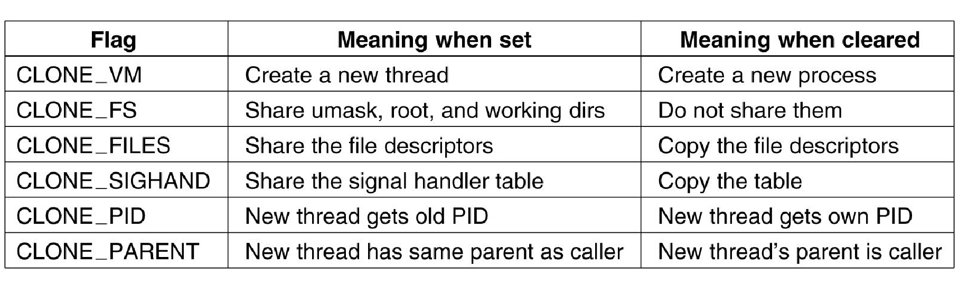
The clone() System Call (3)
Bits in the sharing_flags bitmap (MOS Figure 10-9)

Slide 13
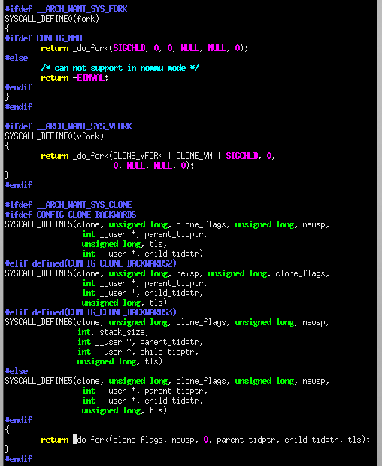
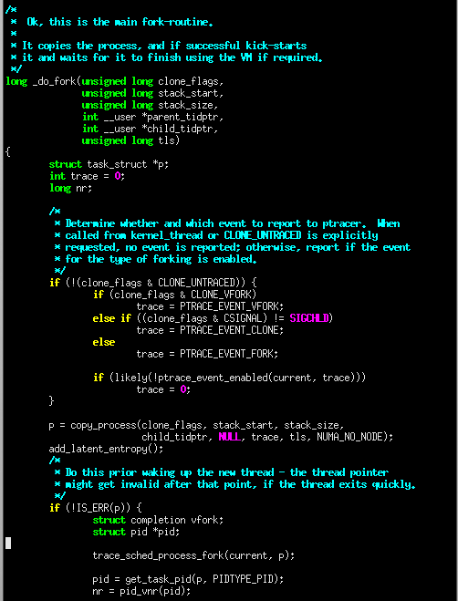
clone() and fork() in Linux
linux-4.9/kernel/fork.c

